Slide 1

Introduction to Redmine
Image Placeholder

Slide 2
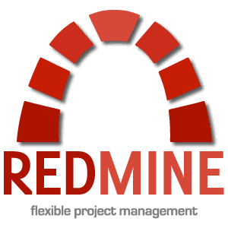
Introduction to Redmine
Redmine is a project management tool written in Ruby. It supports several database servers and is also known as an issue tracking system.
Redmine features:
It is an open-source tool.
Keeps a track of multiple projects.
Allows the user to have different roles and permissions.
Users can track the time that has been spent on the issue.
Users can see visual reporting using graphs and charts.

Slide 3
Redmine Ticket Workflow
PM/TL creates a new task
(set Billable or non billable)
PM/TL sets the Assignee and change the status to Assigned
Requirements are refined and elaborated by assignee to Implement
New
Requirements validation is performed early in the development effort by PO/PM/TL. It will confirm correct understanding and correct of way of implementation
If the Assignee needs some clarification or has any feedback s/he changes the status to Feedback & Assignee to PM/TL
Assigned
PM/TL changes the status to Assigned and change the Assignee for any task that has feedback from the reviewer
Req Definition
Assignee changes the status to InProgress when s/he starts working
Assignee records Spent Time everyday
Req Validate
PM/TL can assign a reopen task to member and can change the status as Assigned.
In Progress
PM/TL can set the closed task status to Reopen, if necessary
Feedback
Close
Submitted
PM/TL (if assigned) will close the ticket if review is successful and clarified the feedback
Reopen
Assignee changes the status to Submitted when s/he finished the task & set the Assignee to PM/TL
Assignee Record Spent time
Reviewed
PM/Assignee changes the status to Feedback and the Assignee to respective engineer in case of review has problem
Assignee reviews and changes the status to Reviewed and Assignee to PM/TL

Slide 4
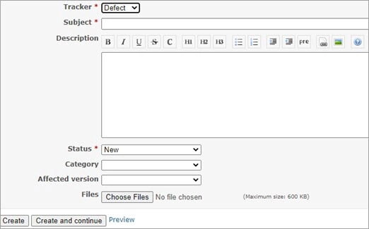
How To Create An Issue
To create a new issue, the users must navigate to the <New Issue> tab present in the header. The users can also select different Trackers like Defect, Feature, and Patch.
For creating an issue, the user needs to fill in the below fields:
Tracker: Indicate the issue category. i.e., Story, Task, Bug, Risk, etc.
Subject: A short and meaningful sentence.
Description: Provide a description of the bug and steps to reproduce.
Status: Provide the status of the bug-like new, assigned, submitted, and closed.
Files: To upload a file, if any i.e., a screenshot of an issue.

Slide 5
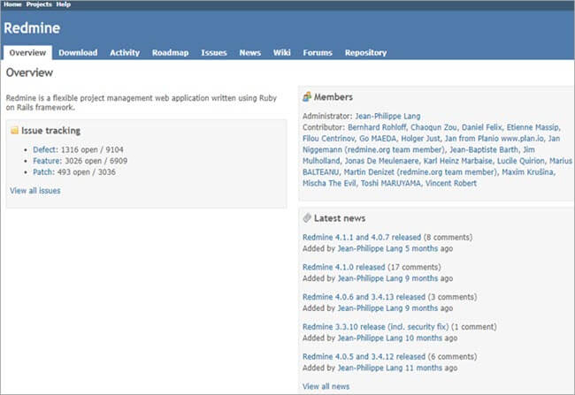
Important Concept Of Redmine
Project Overview
The “Issue Tracking” block on the left-hand side contains the complete status of all the issues that are in open/closed state.
The “Members” block shown on the right-hand side contains all the members related to the project
The “Latest News” block contains all the latest news related to the project.

Slide 6
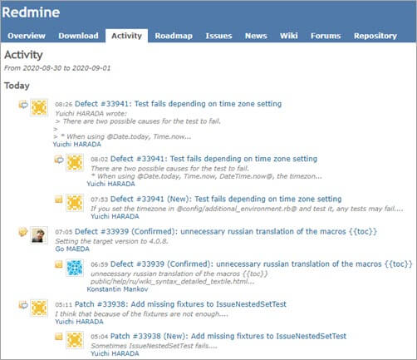
Important Concept Of Redmine
Activity Report
It has all the audit logs or historical information related to the Project or searched issues.

Slide 7
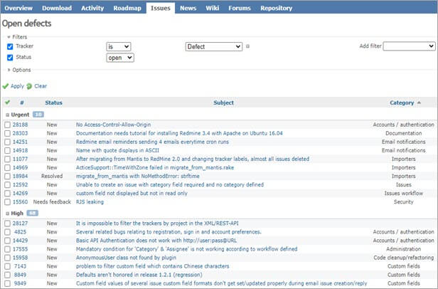
Important Concept Of Redmine
Issue Tracking
#1) Issue List
From here, the users can view the list of issues and can select a specific issue to see it in detail.

Slide 8
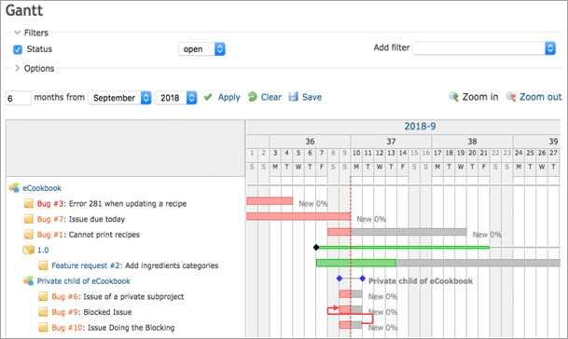
Important Concept Of Redmine
Tracking Progress
Gantt Chart
It is used to track the project’s progress, including the start date, due dates, status, and resolution. It’s a plugin and the user can install it.

Slide 9
Thank You
Image Placeholder

